Slide 1
Linear Regression
Itay Hazan

Slide 2
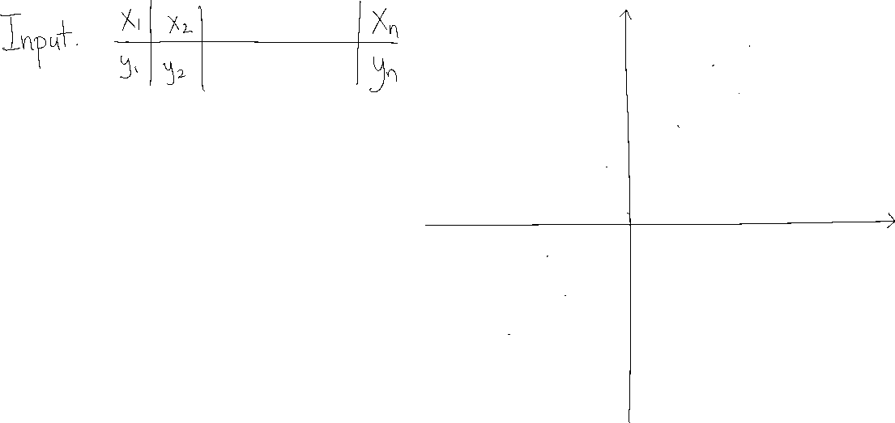
Single-Variable Linear Regression

Slide 3

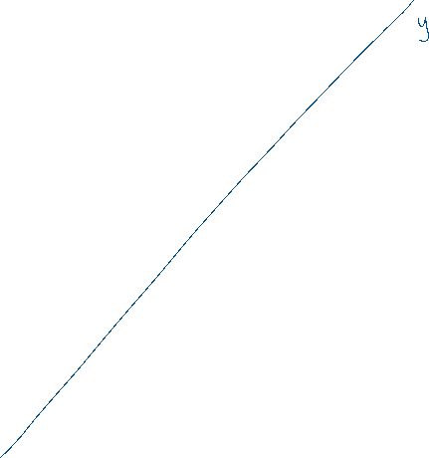




Single-Variable Linear Regression

Slide 4


Single-Variable Linear Regression

Slide 5





Single-Variable Linear Regression

Slide 6




Single-Variable Linear Regression

Slide 7













Single-Variable Linear Regression

Slide 8

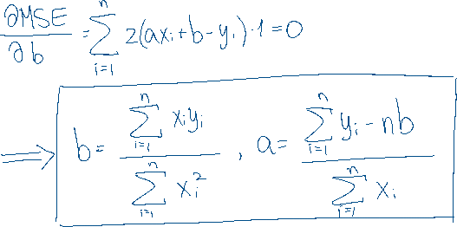
Single-Variable Linear Regression

Slide 9

















Single-Variable Linear Regression

Slide 10







Multivariate Linear Regression

